Slide 1
AUTOMATIC IRRIGATION SYSTEM
SANJAY C

Slide 2
PROBLEM STATEMENT
The problem of automatic irrigation aims to develop a system that efficiently manages the watering of plants in agricultural settings.
This system must address several challenges, including optimizing water usage, monitoring soil moisture levels, and ensuring timely irrigation based on environmental conditions.
PROJECT STATEMENT
This project will integrate cutting-edge sensor technology to continuously monitor soil moisture levels, weather conditions, and other environmental factors.
This project also emphasizes sustainability by reducing water wastage and promoting responsible irrigation practices. Users will have the convenience of remotely monitoring.

Slide 3
BLOCK DIAGRAM
Liquid Crystal Display
Soil Moisture Sensor
Node MCU ESP8266
Mini Water Pump
L2C Module
Relay
9V Battery
Crop Fields
Mobile Notification

Slide 4
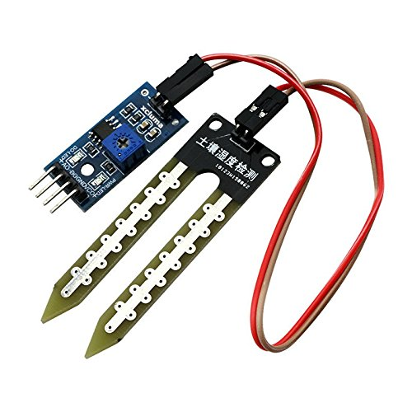
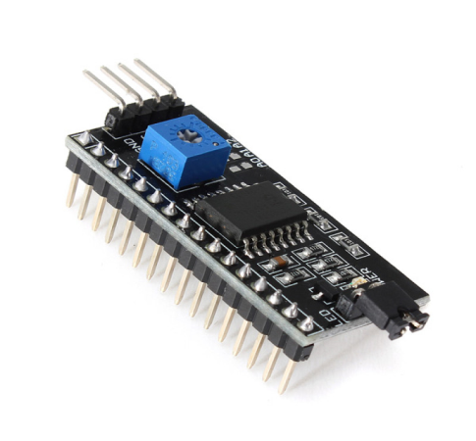
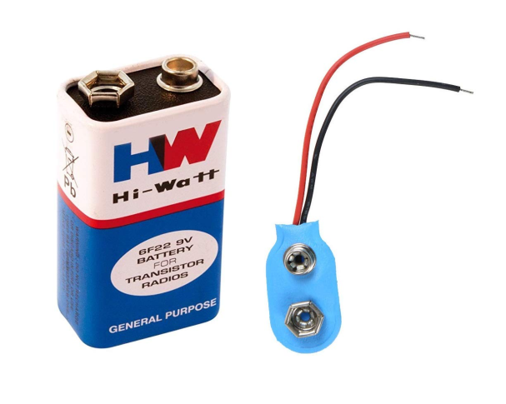
INPUT MODULE
SOIL MOISURE SENSOR: The soil moisture sensor (SMS) is a sensor connected to an irrigation system controller that measures soil moisture content in the active root zone before each scheduled irrigation event and bypasses the cycle if soil moisture is above a user- defined set point.
L2C MODULE: It is a bus interface connection protocol incorporated into devices for serial communication. It was originally designed by Philips Semiconductor in 1982.
BATTERY: A battery is a source of electric power consisting of one or more electrochemical cells with external connections for powering electrical devices.

Slide 5
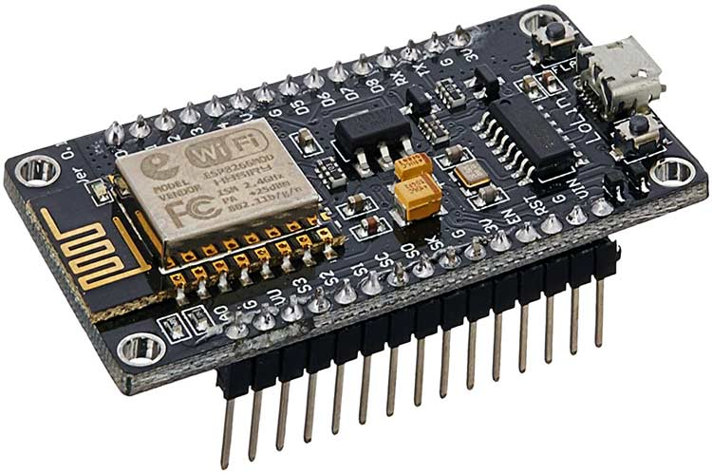
NODE MCU ESP8266
Ai Thinker NodeMCU-ESP8266 is an open-source firmware and development kit that helps you to prototype or build IoT products.
It includes firmware that runs on the ESP8266 Wi-Fi SoC from Espressif Systems, and hardware which is based on the ESP-12 module.

Slide 6
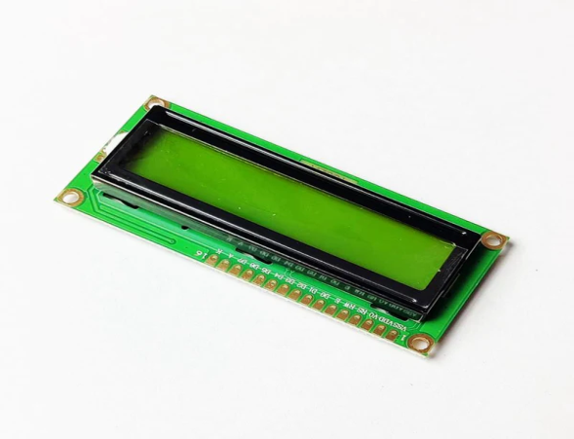
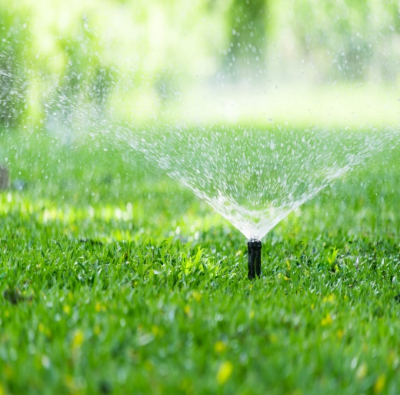
OUTPUT MODULE
LCD: LCD (Liquid Crystal Display) is a type of flat panel display which uses liquid crystals in its primary form of operation. LEDs have a large and varying set of use cases for consumers and businesses, as they can be commonly found in smartphones, televisions, computer monitors and instrument panels.
MOBILE DISPLAY: We can display the results in BLYNK app using mobile phones.
CROP FIELDS AND WATER PUMPS: Automatic irrigation is the use of a device to operate irrigation structures so the change of flow of water from bays can occur in the absence of the irrigator.

Slide 7
PYTHON SCRIPT
#include <Wire.h>
#include <LiquidCrystal_I2C.h>
#include <Adafruit_Sensor.h>
#include <DHT.h>
#include <WiFiClient.h>
#define DHTPIN 2
#define DHTTYPE DHT22
#define SOIL_MOISTURE_PIN A0
const char* ssid = "YourWiFiSSID";
const char* password = "YourWiFiPassword";
DHT dht(DHTPIN, DHTTYPE);
LiquidCrystal_I2C lcd(0x27, 16, 2);
void setup() {
Serial.begin(115200);
lcd.init();
lcd.backlight();
dht.begin();
WiFi.begin(ssid, password);

Slide 8
while (WiFi.status() !=WL_CONNECTED)
{
delay(1000);
Serial.println("Connecting to WiFi...");
}
Serial.println("Connected to WiFi");
}
void loop()
{
float temperature = dht.readTemperature();
float humidity = dht.readHumidity();
int soilMoisture = analogRead(SOIL_MOISTURE_PIN);
lcd.clear();
lcd.setCursor(0, 0);
lcd.print("Temp: " + String(temperature) + "C");
lcd.setCursor(0, 1);
lcd.print("Humidity: " + String(humidity) + "%");
if (soilMoisture < 500)
}
delay(5000);

Slide 9
THANK YOU

